Slide 1
Prioritized Sweeping and other variations of policy evaluation/iteration (with no formula)
Zhuoyu Wang
COMP 762
Jan 27, 2017

Slide 2
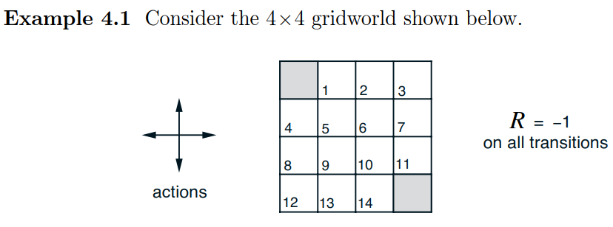
Prioritized Sweeping
Moore and Atkeson (1993): a good idea but using a bad example.
New example from Sec 4.1 of Button and Barto (2016)
MDP (more details on page 82 of Button and Barto (2016) )

Slide 3
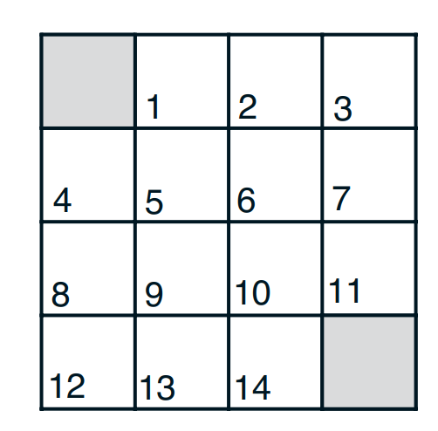
One-step Predecessor
Now, consider an arbitrary state, say 6.
State 6 is a one-step predecessor of state k, k = 2, 5, 7 or 10. The state value ν_{π}(6) is a component of ν_{π}(k).
If there is a big change in an update of ν_{π}(6), ν_{π}(k) should also be updated.

Slide 4
Priority
The state whose value is more largely affected should be updated earlier.
Denote the lasting update: ν'_{π}(6) = ν_{π}(6) + Δ.
Based on this update, we have
ν’_{π}(k) = ν_{π}(k) + Δ*p(s’=k|s=6)
P= Δ*p(s’=k|s=6) determines the priority.

Slide 5
Algorithm
Initial priority queue with (an arbitrary state and a corresponding priority P=0).
Repeat
Remove the top state, say i, from the priority queue.
Update ν_{π}(i) and calculate Δ.
Calculate P_{k}=Δ*p(s’=k|s=i) for each one-step predecessor k of state i.
Add k to priority queue if P_{k}> ε. Sort the queue by P (decreasingly).
Until the priority queue is empty.
Output ν_{π}(s).

Slide 6
Advantage
In each sweep of iterative policy iteration, values of 14 states updated. In each prioritized sweep, only need to update 1 state.
More sweeps are needed for prioritized sweeping, but total calculation is dramatically reduced.

Slide 7
Code demonstration
Iterative policy evaluation
Jacobi-style algorithm (two array version)
Gauss-Seidel-style algorithm (in place version)
Prioritized Sweeping
(3430 vs 1876 vs 1162 sweeps for the given setting)
Policy iteration
Value iteration (modified policy iteration)
Code (in R) available at https://github.com/rllabmcgill/rlcourse-january27-zhuoyu

